Slide 1
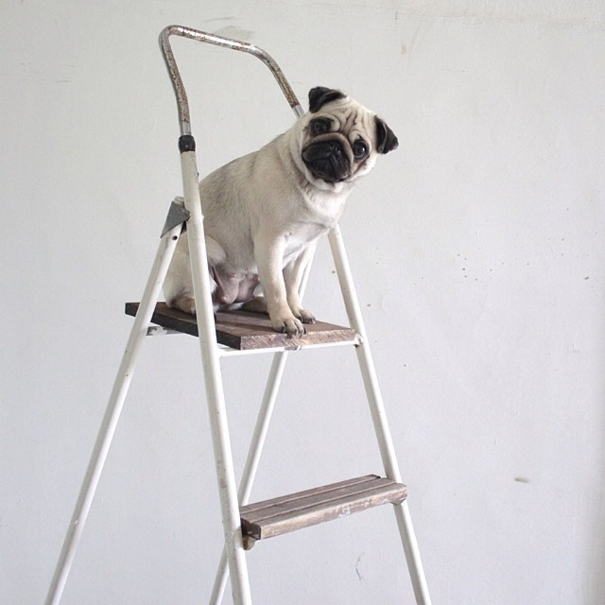
Ladder Safety
Using the correct ladder

Slide 2
Ladders are essential tools on a variety of job sites, easy to obtain and simple to use.
With proper planning and training, you can address the life-threatening hazards that come with using ladders while on the job
According the American Academy of Orthopedic Surgeons, every year 500,000 people are treated for ladder-related injuries and approximately 300 of these incidents prove to be fatal.
In 2007 alone, more than 400 people died as a result of falls on or from ladders or scaffolding. -Liberty Mutual - Research Institute for Safety

Slide 3
Fall related injuries within the district
In the past there have been a number of injuries
Directly related to ladder use
Using something other than a ladder to climb on
The following slides show examples of some of the incidents

Slide 4
Examples of injuries related to falls within the district
Employee working on bulletin board stepped down from chair lost their balance and fell on their back
Employee climbing down from ladder carrying tool bag missed stepped and fell, injuring multiple body parts.
Employee standing on a counter to place art work on wall lost their balance. Injury to arm & twisted back from open cabinet door.
Employee using a step ladder to retrieve items off a shelf slipped and fell. Injury to shoulder, arm and leg.
Notes:
These are actual injury cases that have occurred within the district.
Its never a good idea to stand on a chair, table or even a counter to retrieve an item or work above. Take the time to get the correct type of ladder.
If you need to carry tools on a ladder try to use a tool belt. Take extra precaution and remember the 3-point contact rule. 3-point contact rule is 2 hands & 1 foot or 1 hand & 2 feet that are always making contact with the ladder.
Having non-slip soles on when using a ladder is important to help prevent you from slipping on a ladder. Also prior to using a ladder inspect the rungs to ensure there isn’t grease or anything else that may pose a slip hazard.

Slide 5
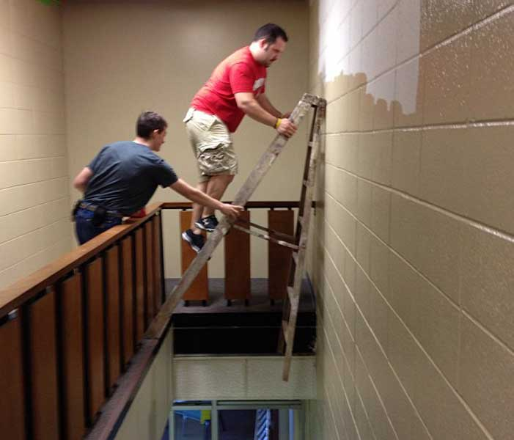
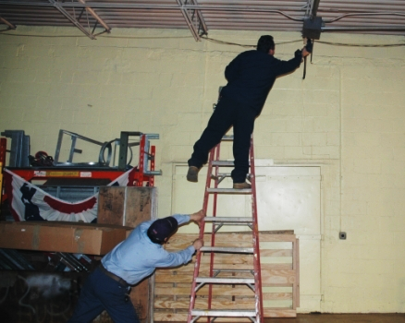
The Main Types of Ladder Accidents
Using the wrong type of ladder for the job
Using a damaged ladder
Falls from over reaching or incorrect ladder placement
Notes:
Some industries face very unique challenges, but there are always a few that remain the same. Ladder accidents occur because of complacency. People have been climbing ladders since they were little children on the playground, and they don't think of ladders as safety equipment.
According to OSHA the majority of the falls are caused by misuse, faulty ladders or carelessness .
Statistics still show that we continue to use the wrong type or size of ladder for the job. Quite often, an individual doesn’t want to carry the correct ladder that is actually tall enough to do the job because it’s too heavy, so they grab the smaller one. And when they have to reach a little higher, they just climb on the top rung or the top cap (top of ladder).
How many times have you grabbed a ladder and not bothered to actually inspect it prior to use? Making sure you inspect a ladder prior to use is just as important as selecting the correct type of ladder. It doesn’t do you any good if the ladder you use is damaged.
This last category is by far the most costly per incident, both in financial and human costs: falls from height due to over-reaching or improper setup. These are the kinds of falls that change lives or end them, the kinds of falls that result in families left behind.

Slide 6
Even Low Heights Can Be Deadly
This doesn’t appear to be safe? Would you do
this?
Most fatalities involving ladders occur below how many feet?
Notes:
Most fatalities involving ladders occur below ten feet!
Most people do not think about this. After all, ladders are one of those tools we use every day and take for granted. Yet, if a falling accident
occurs from a ladder, the chances are the accident will result in injury or death. Any fall can be serious, and a fall from the height of even a low ladder can mean a painful and incapacitating injury.
Besides the expense of Worker’s Compensation Claims, the really important issue is the pain and suffering a fall injury may bring to you as a
victim, or to your survivors and the lost productive time to your employer.
Fortunately, almost all falls are preventable – if the fundamentals of ladder construction, use and safety are understood.

Slide 7
labels
Several labels can be found on a ladder
Safety Instructions
Danger & Caution labels
Duty rating, load capacity, ladder size, maximum reach, highest standing level & model (ID) number
What part of the ladder will you find a Danger label ?
Notes:
A Danger label may be found on upper rung (step) & side rail
The terminology of Ladder Grades, Duty Ratings, and Types may initially be confusing to some. Remember that the Duty Rating is the maximum safe load capacity of the ladder. Hence, Duty Ratings are described in terms of pounds, such as a 300 lb. Duty-Rated Type IA ladder which is designed for extra heavy duty professional use where the total weight on the ladder does not exceed 300 pounds.
The label that contains the Duty Rating also has other viable information such as size of ladder, load capacity, the maximum reach, highest standing level, model (ID) number and even the UPC code
Other labels on ladders should be legible. If they become worn or incomplete replace the label. Cal-OSHA requires any ladder put into use after January 7, 2011 must meet design & construction requirements of American National Standards Institute (ANSI) A14.1-2007 for wood ladders, A14.2-2007 for metal ladders & A14.5-2007 for reinforced plastic constructed ladders. Portable ladders placed into service on or before January 7, 2011 shall meet the requirements of the standard in effect at the time such ladders were placed into service. This means if labeling was required at the time the ladder was placed into service it will need to have it!

Slide 8
Select the correct duty rating for a 245 pound worker carrying 15 pounds of tools/ equipment
Light Duty
200 lbs
Type III
Household Use
Medium Duty
225 lbs
Type II
Special Duty
375 lbs
Type IAA
Heavy Duty
250 lbs
Type I
Extra Heavy Duty
300 lbs
Type IA
Notes:
The Extra Heavy Duty 300 lbs, type 1A ladder would be the appropriate choice for a 245 pound worker carrying 15 pounds of tools/equipment.
Ladders are designed and constructed to safely hold up to a specific amount of weight. Ladders come in different Duty Ratings identified by their grade and type. The Duty Rating is defined as the maximum safe load capacity of the ladder. A person's fully clothed weight plus the weight of any tools and materials that are carried onto the ladder must be less than the duty rating. Do not assume that a longer ladder has a higher duty rating. There is no relationship between length and duty rating.
Pay attention to the different classes and choose the ladder that suits your needs.
You should consider both the weight which will be on the ladder and the work application and to select the proper grade of ladder which is designed to handle anticipated usage.
The American National Standards Institute (ANSI) requires that a duty rating sticker be placed on the side of every ladder so users can determine if they have the correct type ladder for each task/job.

Slide 9
Can you list two things wrong in the picture
Notes:
Some of the things being done incorrectly in the above picture:
1. Makeshift ladder. What would happen if the ladder shifted or the loader moved?
2. Worker sitting on the rung. Where is the 3-point contact of 2 feet-1 hand or 2 hands 1 foot?
If you are unable to access the area by using the correct type of ladder that is tall enough the alternative may involve using a mechanical device such as an aerial lift or bucket lift.
Does it look safe to you?

Slide 10
Determining the type of ladder needed
What is the size and type of ladder you will need?
Will you be working with or around electrical energy? If so, a non-conductive ladder will be required.
Check ladder load capacities
Are you using a wood, fiberglass or aluminum ladder?
Notes:
Take the time to get the right size and type of ladder and not the most available one. Will you be accessing a roof where an extension ladder is needed or will a step ladder be sufficient to change a light? Use the correct ladder for the job not too big or too small.
Portable ladders must:
Be long or tall enough to safely reach the work area.
Have a load rating that can support the weight of the user, materials and tools.
Have non-conductive side rails when used near energized equipment.
It is important that you always use a ladder that is appropriate in size and construction for the task at hand.
Three types of materials most commonly used:
Wood
+ non-conductor of electricity when dry
+ the best natural insulator against heat of all materials
- ages very fast
Fiberglass
+ non-conductor of electricity
+ dense material and is slower to conduct heat than metals
+ ages very slow
- heavier than aluminum or wood models
- Despite their strength and durability, fiberglass ladders can be broken, cracked, gouged or punctured if not protected from damage, or used improperly
Aluminum
+ in general are tough
+ age very slow
+ will not chip or crack when subjected to severe impact
- can conduct electricity. For this reason it is not recommended if working around electric current
- not a good insulator against heat

Slide 11
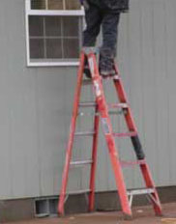
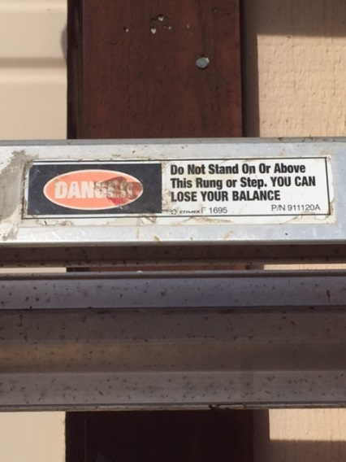
Ladders can be dangerous if not used correctly
Using the wrong ladder for the job
Using ladders incorrectly
Using defective ladders
Is this ladder designed for standing like this?
Danger – Do Not stand on or above this step.
Notes:
Using the wrong ladder could cause you serious injury or in a worst case, DEATH. If you need to access a roof or lean a ladder against a building don’t use a step ladder. Instead, use an extension or straight ladder.
As you can see in the picture the worker is straddled on top of the ladder. Climbing on or above the posted warning on the ladder step could cause the ladder to become unstable thus tip over and worker to fall – Not a safe way to do work!
Before using any ladder it’s important to inspect the ladder for any defects; this can be the difference between doing a job or being injured while doing a job.

Slide 12
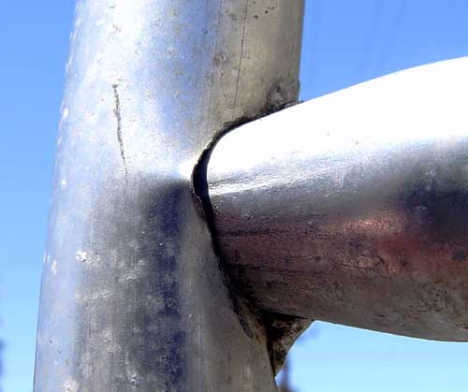
Condition/Inspection
Keep portable ladders in good, usable condition
free of oil, grease, wet paint, and other slipping hazards
Joints between steps or rungs and side rails are tight
Rungs, cleats, or steps are not bent, broken or split
All bolts and rivets are in place and secure
Hardware, fittings and accessories are securely attached and working properly
Ropes are not frayed or badly worn
Notes:
Most likely you don't use your ladder every day, or even every month. For this reason, it is important that you inspect the ladder for flaws before you climb up. Ladders shall be inspected by a qualified person for any visible defects frequently and after any occurrence that could affect their safe use.
Be sure to check that all rungs are secure. Look for loose nails, screws, hinges or bolts.

Slide 13
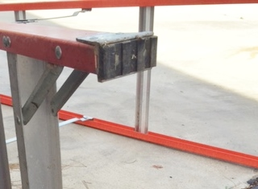
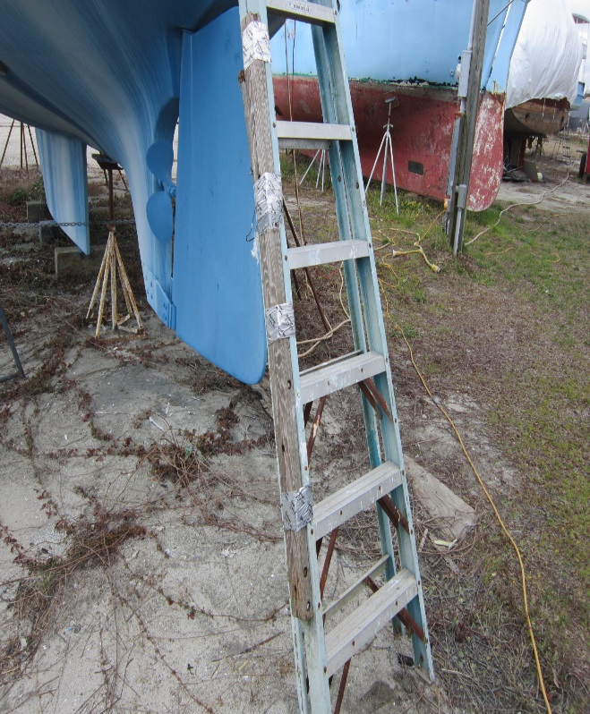
What is the condition of the ladder
Do these ladders meet code?
Don’t paint wood ladders
Do moveable parts operate freely without grinding or excessive play
Metal components are not corroded
Ensure that slip-resistant feet are in good condition
Are there broken or defective components
Are labels legible or are any missing
Notes:
If you are using a wooden ladder, be sure that no part is warped or splintered. In addition wood ladders shall not be painted with other than a transparent material.
Check to be sure that the slip-resistant feet are even & in good condition and that the ladder does not wobble.
lastly, verify that the labels are still intact and are legible.
Damaged Ladders
Ladders that have developed defects shall be removed from service for repair or destruction and tagged or marked as “Dangerous, Do Not Use”. Ladders with broken or missing steps, rungs, cleats, safety feet, side rails, or other defects shall not be used.

Slide 14
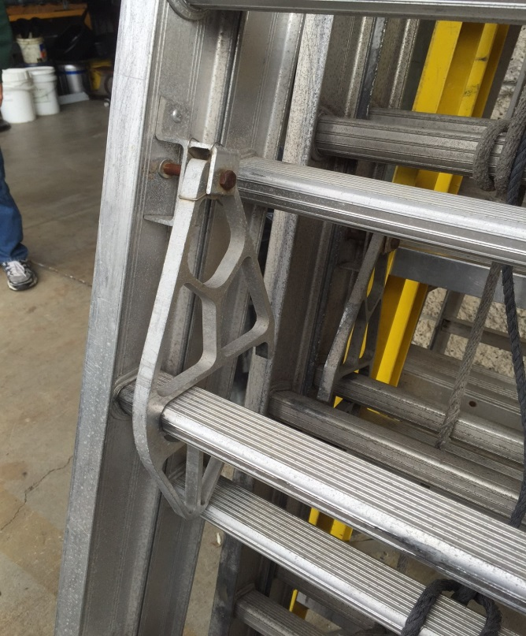
Check the Locks
Not Fully Locked
Locked (seated around Base)
Always check to be sure the extension locks are properly seated
Notes:
When using an extension ladder, raise it to the desired height, being sure the locks engage properly on both sides of the ladder.

Slide 15
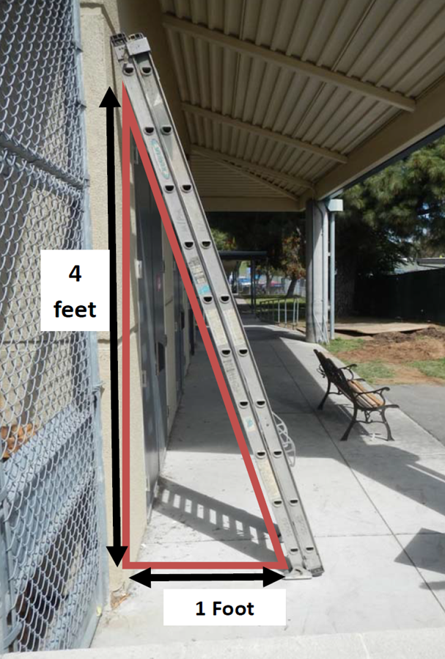
Setting up the Ladder
Make sure the ladder is placed on an even surface and that the ground is not too soft to prevent sinking
Use the 4 to 1 ratio against a base for straight or extension ladders
If using straight or extension ladders to access roof extend 3 rungs (3Feet) above the roof surface
Notes:
Firm Base - Set both feet level and on the pads
Soft Base - Set on the spikes and seat the ladder in the ground.
Also consider using an anti-slip ladder device if working on slippery surfaces.
To ensure you choose the ladder best suited to your needs, use the recommended guidelines.
Use the 4 to 1 ratio when setting up a straight/extension ladder – for every 4 foot in height the base should be 1 foot out
Position straight/extension ladders so the side rails extend at least 3 feet above the landing. Secure side rails at the top to a rigid support and use a grab device when 3 foot extension is not possible. Always raise extension so that the upper section overlaps and rests on the bottom section.
The upper section must always overlap on the climbing side of the extension ladder.

Slide 16
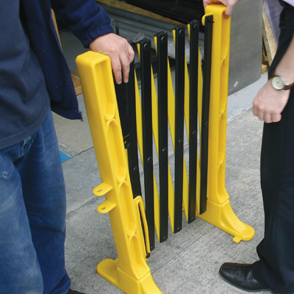
Ladder Placement
Barricade off area below and/or around your ladder so pedestrians don’t walk into or under your ladder while you’re on it.
Barricading can help prevent you from dropping something on someone passing close by.

Slide 17
Match the names to the corresponding area on the ladder
Anti-slip shoes/feet
Front Side Rail
Labels
Spreaders
Top Cap
Step
Rear Side Rail
Top Step
Notes:
Answers
1. Top Cap, 2. Top Step, 3. Front Side Rail, 4. Step, 5. Anti-slip Shoes/Feet, 6. Spreaders, 7. Rear Side Rail, 8. Labels.
Never lean a self supporting step ladder and erect it only on a flat level surface. Before climbing a stepladder, make sure that its legs are fully extended and the spreader locked. The locking device may present a pinching hazard, so keep fingers clear when setting up the ladder.
Do not step on the bucket shelf or attempt to climb or stand on the rear section supports. They are not designed to support the weight of a person.

Slide 18
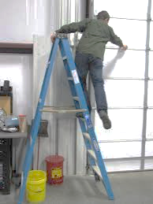
Climbing Tips
Maintain three-point contact at all times
Hold the side rails not the rungs when climbing or descending a ladder
Only take one step at a time
Do not stand on the top step of a “A-frame” ladder.
Use a tool belt to keep hands free
Lift materials from a hand line bucket from the ground
No three-point contact being maintained
Notes:
When climbing maintain a three-point contact at all times - means two feet and one hand or two hands and one foot which is safely supporting the user’s weight.
Avoid excessive stretching or leaning - which could cause you to slip & fall resulting in serious injury. Workers should never work with one leg on a ladder and one off.
Only one person on a ladder at a time

Slide 19
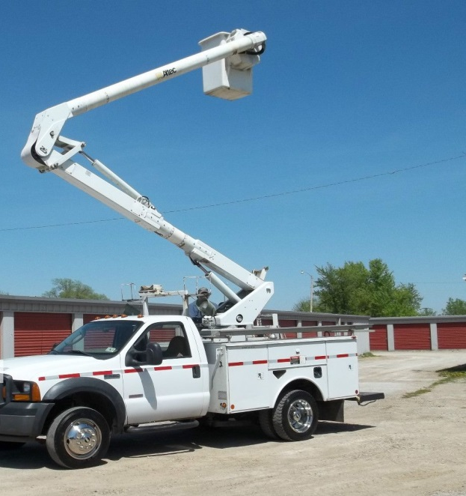
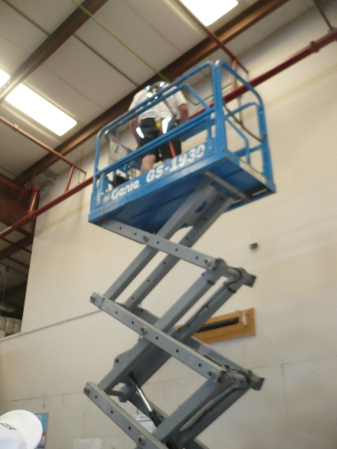
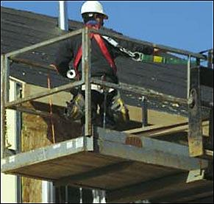
Other Options
If a ladder is not the best option consider using a mechanical device
Notes:
There may be times when a ladder is not practical and a mechanical device such as an aerial lift, scissor lift or bucket lift would be a better choice for the job task at hand.
Prior to using any piece of equipment you need to be trained on how to safely operate, any necessary precautions or personal protective equipment (PPE) and any pre or post inspection requirements. Never use a mechanical equipment during windy conditions since there is a potential for the equipment to tip over.
Ensure that the manufacture’s manual is with the equipment at all times.

Slide 20
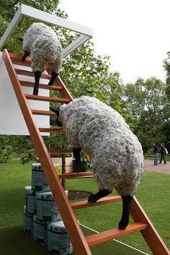
Don’t be a fool, use the proper tool~ Author Unknown
Contact the Safety Office at 858-627-7174 or safetyoffice@sandi.net

